Slide 1
Security in IOT devices
Mid year review
By kai tindall (201842748)
https://github.com/kTindalland/HonoursProject

Slide 2
Project Overview
The main aim is to create encrypted, trusted communication between a server and IOT device.
This is all Linux based.
Because I don’t have any qualifications in cryptography, I am using a cryptography library to handle the implementation of actually doing the encryption.

Slide 3
Encryption
The main encryption method being used will be AES. This is the main encryption standard used by the majority of people (Levchin Prize, n.d.).
I will, if I have time, implement two other methods for use in comparison between AES.

Slide 4
Signing
Signing means that you produce a hash using your private key, that can only be verified with your public key. This is useful for proving who you are.
This is where the project will get the trusted part of the aim from.

Slide 5
Key Generation and Key Exchange
Key generation refers to how keys are generated for use in a public and private key. I will be using Elliptic Curve key generation.
Key exchange is the process of exchanging a key with another entity in plain sight of everyone and still only producing keys which only the people intended can read. I will be using a Diffie-Helman key exchange.

Slide 6
Hashing
Hashing is the process of putting data through an algorithm where it is easy to get the result from the original data but very hard to get the original data from the result.
I will be using SHA3 as my chosen hashing algorithm as it’s the latest and most secure in the mainline SHA algorithms.

Slide 7
Crypto++ Cryptography Library
The crypto++ library is a library that has a lot of different cryptographical functions within.
It is used a lot in both for-profit and non-profit projects (Crypto++, 2019).
It allows me to use a lot of cryptographic functions without having to write them myself. This saves time and I might not implement a function correctly if I tried.

Slide 8
Reports
I started out doing weekly and monthly reports that would look at how the project was going and correct accordingly.
As work started to ramp up, the reports got left behind as I was concentrating on various pieces of coursework and exams.
Overall I do think it’s a good idea, it forces me to reflect on the passed week and month and implement actions that need doing to correct the course.

Slide 9

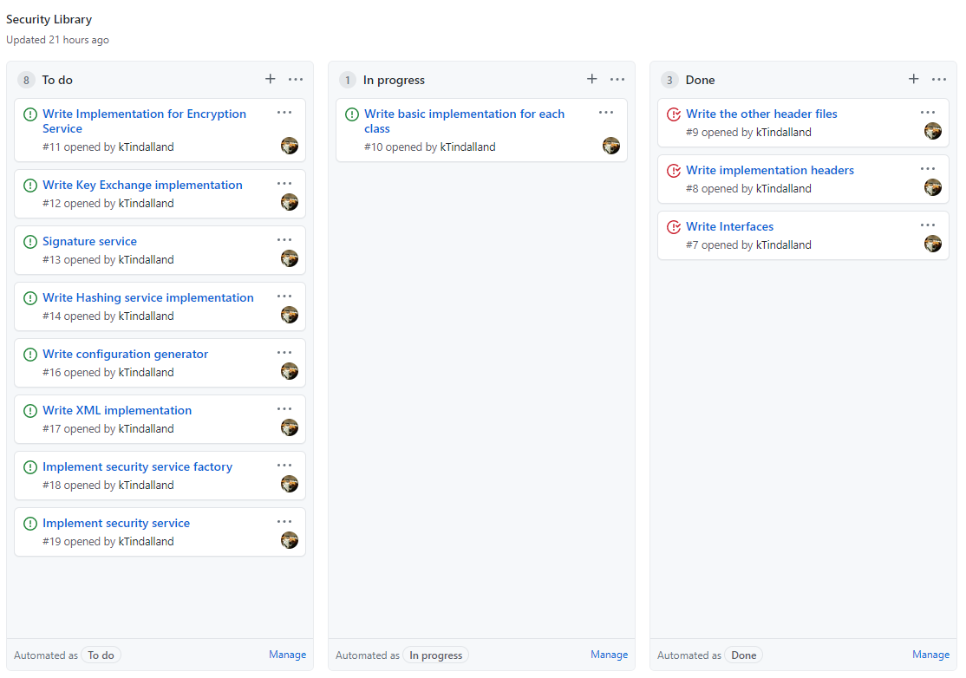
Agile Management
Agile management hasn’t been utilised properly yet.
However recently with the development of the security library a new board has been created with a lot of issues that need to be done.

Slide 10
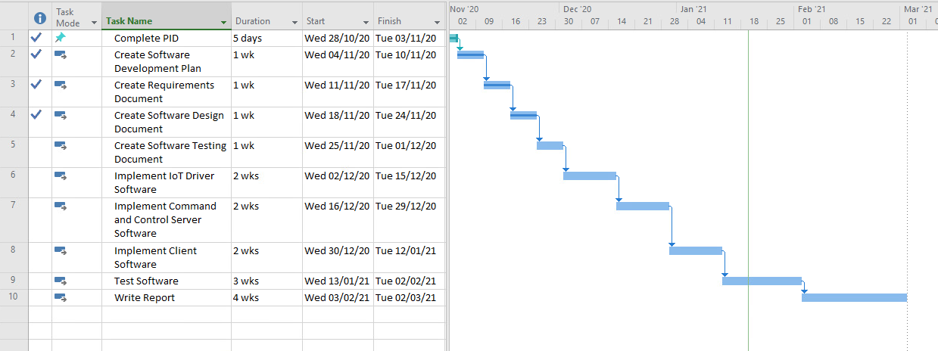
Original Plan and Current Progress

Slide 11
New Plan
Follow the design, that’s what it’s there for after all. Hopefully should significantly speed up the implementation.
Develop “utility” libraries (Security, Messages)
Develop Public Information Registrar.
Develop Command and control server
Develop Device Driver
Develop Client (Time restrictions might push me towards a windows alternative as I don’t have much experience in C++ GUI)

Slide 12
Reflections
I should have accounted for the “crunch” in time that happened when I had deadlines and exams.
Project management has been poor on my part.
I spend too much time on the design when I should have been pressing on.
Reports are as an idea a good one, I should continue them and not be intimidated by coming back to it after not doing it for a while.

Slide 13
Questions?
Crypto++, 2019. Related Links - Crypto++ Wiki [WWW Document]. Crypto++ Website. URL https://www.cryptopp.com/wiki/Related_Links#Commercial_Products_Using_Crypto.2B.2B (accessed 1.20.21).
Levchin Prize, n.d. The Levchin Prize for Real-World Cryptography [WWW Document]. URL https://rwc.iacr.org/LevchinPrize/winners.html (accessed 1.20.21).

